Slide 1
Python Programming
Dr. Ananda Kumar Kinjarapu

Slide 2
The way to get started is to quit talking and begin doing.
Walt Disney

Slide 3
Topic one
Introduction to Programming Concepts with Scratch

Slide 4
Agenda
Scratch Environment, Looks and Motion
Repetition and Variation
Working with Sounds and Sprite Communication
Input/Output, Variables and Simple computation

Slide 5
part one
Scratch Environment, Looks and Motion

Slide 6
objectives
Learn Scratch programming environment
Learn the looks and motion menus
Write a sequence of instructions.

Slide 7
Introduction
With Scratch, you can learn some computing concepts and practical algorithms, use as a computing tool, and have fun by creating stories, games and arts.
You can download scratch from https://scratch.mit.edu/download.
You can create and interact online at https://scratch.mit.edu/projects/editor/?tutorial=getStarted.

Slide 8
Scratch Environment
Stage is at upper right (where actors act, and information is displayed)
Sprite is another name for actor.
Instruction menus/panel at left (instructions for the actors)
A script is another name for program or method; a script tells the actor what to do.
Programming area in center; here is where we construct scripts for the sprites

Slide 9

Scratch Environment
We start with the cat sprite.
We will learn to use many other sprites later.
For now, we use the cat as our only actor. We script the BEHAVIOR of our cat.

Slide 10
Looks Menu
Has instructions for setting the color, size, and visibility of a sprite.
Costumes will be used later.

Slide 11
The ‘hell0’ script program
Choose the Looks menu.
Click on the “say hello” Lego (a construction toy consisting of interlocking plastic building blocks) block.
Check your sprite behavior at the right.
Then click “say hello for 2 secs”.
Check your sprite behavior at the right.

Slide 12
The ‘hell0’ script program
Click on change color effect by 25.
Click on change color effect by 25 again.
Click on hide.
Click on show.
Click on change size by 10.
Click on change size by 10 again.
Click on set size to 100%.

Slide 13
Let’s write a script
Say “hello” for 2 seconds
Then change color effect by 25
Then think “Hmm..” for 4 seconds
Then change color effect by 75
Then change size by 200
Drag each instruction from the menu to the center script area. Connect them into a single block. Edit the parameters to get the numbers we want.

Slide 14
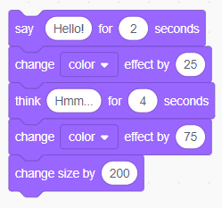
Let’s write a script
A sequence or block is a simple script or program.
Instructions are executed in the order of top to bottom.
If you click any one instruction, entire block of instructions are executed.

Slide 15
Wait instruction
WAIT is needed to slow down the acting so we can see or hear it properly (computers are too fast sometimes)
Get the wait instruction from the CONTROL menu. Ignore the other menu options for now.
Insert a wait in our looks script

Slide 16
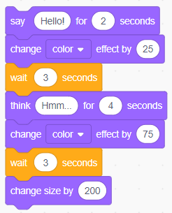
Insert Wait into look script
3 second pause between changing color and size

Slide 17
Student exercise
Double the size of the sprite
Wait 2 seconds
Change the color of the sprite to green
Wait 4 seconds
Change the whirl effect to 100
Say “That’s all folks!”

Slide 18
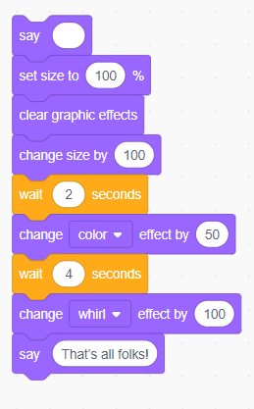
Student exercise-Answer

Slide 19
The MOTION menu
How to locate and orient a sprite; moving a sprite.

Slide 20
Position on the stage
Using the Looks menu, shrink our cat to 25%.
Click on the Motion menu.
Click to check the box for x-position and y-position
Drag your cat around and note its x-y position.

Slide 21
Position on the stage – go to
In the Motion menu, drag the “go to x y” instruction to the script panel.
Edit the following coordinates and click to see the sprite’s position and Observe the sprite position changes.
x=200, y=0 (positioned Horizontally right and vertically center)
x=-200, y=0 (positioned Horizontally left and vertically center)
x=200, y=-100 (positioned bottom right)

Slide 22
Position on the stage – glide to
In the Motion menu, drag the “glide secs to x y” instruction to the script panel.
Change the x and y values and Observe the sprite position changes.
x=-169, y=-102 (dragged from current position to the specified position.

Slide 23
Student exercise
Create a script to glide the sprite along the sides of a triangle. The first vertex of the triangle is (-100, -100). The second vertex is (200, -100). The third vertex is (50, 100). Make sure you complete the triangle.
Change the speed of gliding and run again.

Slide 24
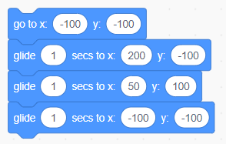
Student exercise-Answer

Slide 25
Angles and directions
Making your sprite go this way and that way.

Slide 26
Motion example script
Start at ( -100, 100 )
Move 100 steps
Turn right 90 degrees
Move 100 steps
Turn right 90 degrees
Move 100 steps
Turn right 90 degrees
Move 100 steps
Turn right 90 degrees
Use waits if needed to make the motion look smooth

Slide 27
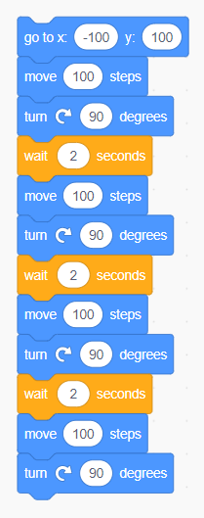
Motion example script
Start at ( -100, 100 )
Move 100 steps
Turn right 90 degrees
Move 100 steps
Turn right 90 degrees
Move 100 steps
Turn right 90 degrees
Move 100 steps
Turn right 90 degrees

Slide 28
Student exercise
Sprite starts at home base at x=-100; y=-50
Sprite says “I hit the ball” for 2 seconds
Sprite runs (east) 200 steps to 1st base
Sprite changes color
Sprite runs 200 steps to 2nd base (north: left turn from 1st base)
Sprite doubles size
Sprite says “I hit a double” for 5 seconds

Slide 29
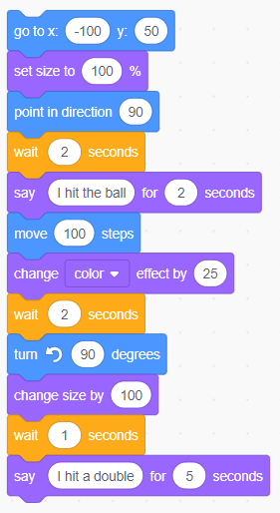
Student exercise-Answer

Slide 30
part one outcomes
Student should be able to control the looks of a sprite and its location on the stage.
Students should be able to construct sequences of instructions controlling looks and location on the stage

Slide 31
part Two
Repetition and Variation

Slide 32
objectives
Learn how to program with repetition
Learn how to change costumes
Learn to control execution (behavior) using special keys.

Slide 33
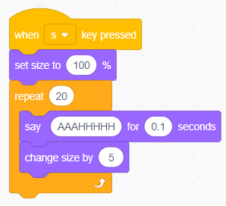
The sneezing cat script
We repeat 20 times
Say “AAAHHHH” for a short time
Then grow the cat 5% bigger
Repeat N times and repeat forever are in the Control Menu

Slide 34
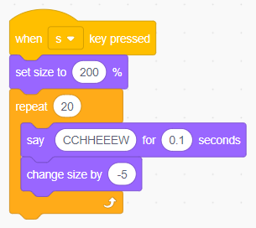
Exercise: bring the cat size down to normal
We repeat 20 times
Briefly say “CCHHEEEW”
Then shrink the cat by 5%
Do this followed by the previous example

Slide 35
Student exercise
Repeat from the Control menu: set the number of repetitions to 18
Rotate from the Motion menu: set the size of each small rotation to 20 degrees.

Slide 36
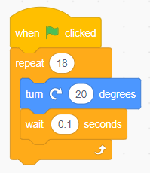
Student exercise-answer

Slide 37
Changing costumes
Another way to change the appearance of a sprite.

Slide 38

Making a new costume to animate the bat
Get bat sprite from the “sprite box”.
Delete cat sprite
Click on bat sprite
Click on “Costumes”
See 4 costumes available

Slide 39
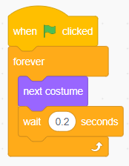
Use a loop to make the bat fly!

Slide 40
Changing coordinates
We can randomly set the location of the bat so it will “flutter”.
Set X to a random number
Set Y to a random number
Move the bat to location (X,Y)
Of course, the bat should remain on stage!

Slide 41
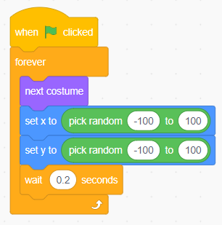
Using pick random

Slide 42
Controlling the bat’s direction
Let’s create multiple scripts.
Click space bar for random moves
Click right arrow to move right
Click left arrow to move left
The bat will behave differently depending upon which key is typed!
(So, could a gamer catch the bat?)

Slide 43
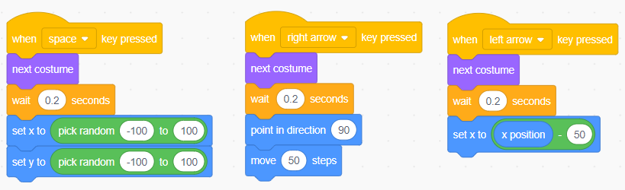
Multiple interactive bat flight

Slide 44
Adding a background
Click on the Stage icon at lower right
Click on Backgrounds
Click on bat icon (Sprite1)
Click on Scripts
FLY AGAIN!

Slide 45
Student exercise
Add a behavior (script) to move the bat up with the up arrow.
Add a behavior to move the bat down with the down arrow.

Slide 46
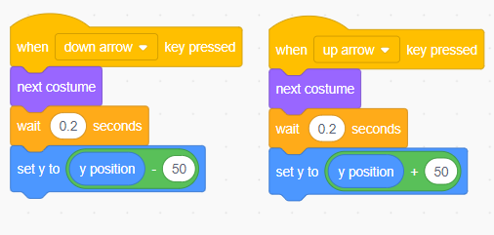
Student exercise-answer

Slide 47
part TWO outcomes
Student should be able to write a program controlled by a loop and execute a script by clicking special keys.
The student should also know how to use “costumes” to change the appearance of a sprite

Slide 48
part Three
Working with Sounds and Sprite Communication

Slide 49
objectives
Learn how sprites can communicate by sending messages.
Learn how to play sounds and to input your own voice.

Slide 50
Communicating sprites: taking turns by message passing
Get cat and dog sprites.
Select the dog sprite and flip the dog vertically such way that it is looking towards the cat.
Suppose cat speaks first. When finished, the cat can send a message to the dog to speak.
When the dog is finished speaking, the dog can send a message to the cat to speak.

Slide 51
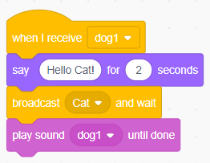
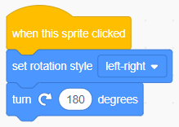
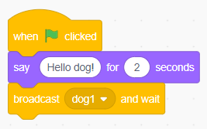
Script for sprite communication
Flip the dog
First behavior of cat
Response of dog

Slide 52
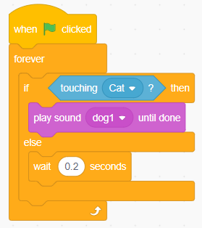
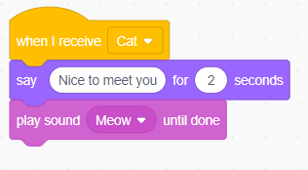
Script for sprite communication
Cat’s reply to dog’s message
Dog’s reply to cat’s 2nd message

Slide 53
Sprites can have many behaviors
Activated by clicking green flag.
Activated by clicking the sprite.
Activated by a key being pressed.
Activated by a message from another sprite.
Activated by touching another sprite.

Slide 54
Using sounds
Sound library; Speaking in the mike; Importing music

Slide 55
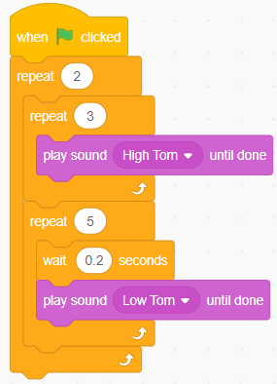
Composing drumbeats

Slide 56
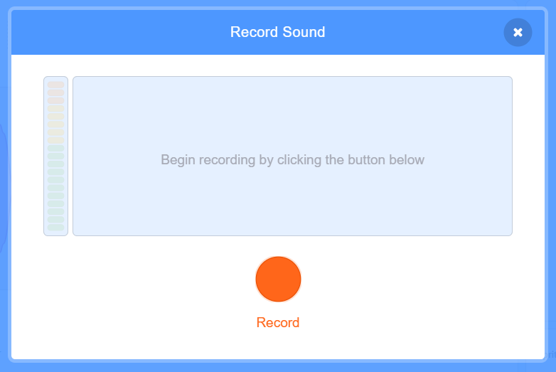
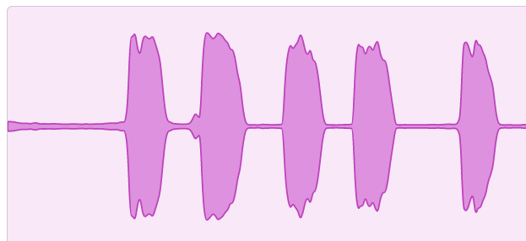
Recording from a mike (or an iPod or other music player)
steps
Record screen
Recording clip
Select the sound tab
select record option by clicking sound icon at the bottom.
Give microphone permissions
Click record button, say something over microphone, test it and save it.
Use that recording.

Slide 57
Narrating stories
Have several scenes
Scenes change with messages or variables.
Make characters move
Make characters hide or show
Behavior can change with variables, touching, mousing.
Background music for each scene.
You can learn by visiting tutorials section.

Slide 58
part three outcomes
Students should be able to program by passing messages.
Students should be able to program their sprites to make sounds.

Slide 59
part four
Input/Output, Variables, Simple computing.

Slide 60
objectives
Learn how the user and the program can communicate
Learn how to compute with formulas
Learn how to Compute an average, perimeter of a geometric figure, etc.

Slide 61
Sensing menu
Getting information from the user or some other machine.

Slide 62
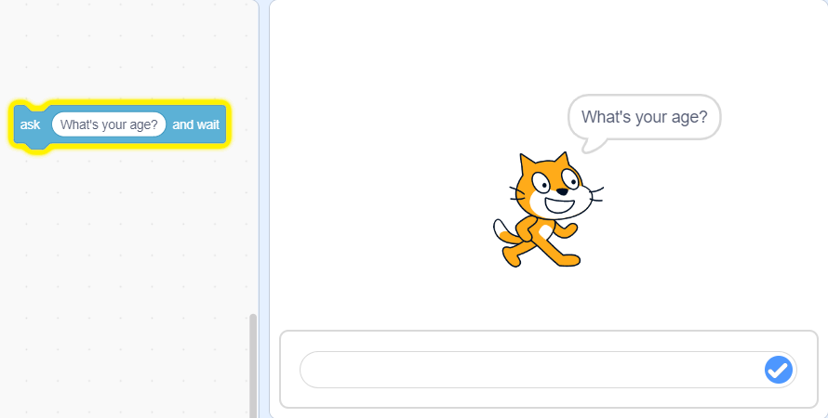
Asking the age of the user
Program wants age of user (maybe to set a level of difficulty in a game)
Program asks user for age
User types in age
Program stores the answer in a special scratch variable named “answer”.
Variables used to remember information.

Slide 63
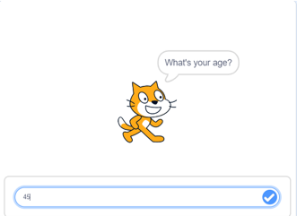
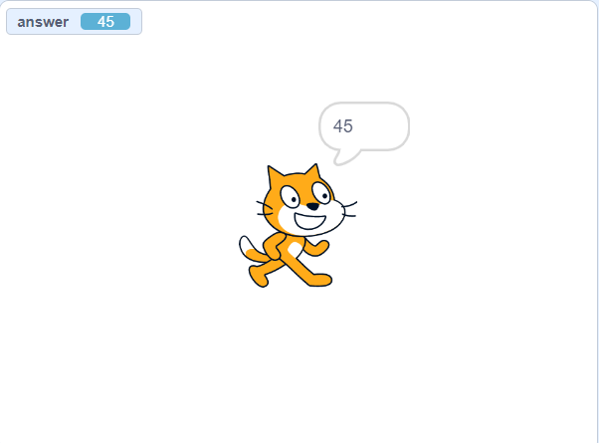
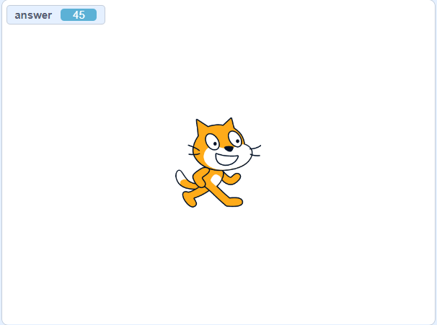
Asking the age of the user
Enter the age in the bottom box below the stage and hit enter
Click on answer in the sensing menu
Outputting the answer using “say answer”

Slide 64
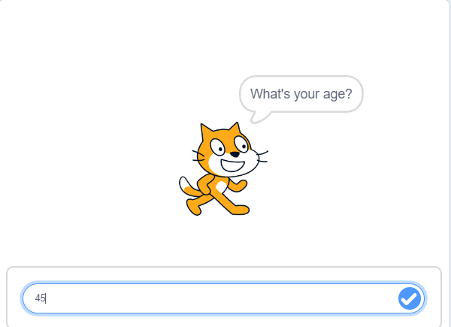
Asking the age of the user
Enter the age in the bottom box and hit enter
Click on answer in the sensing menu

Slide 65
Variables menu
We can save “answer” in our own named variable;
we can program with many data items using many variables.

Slide 66
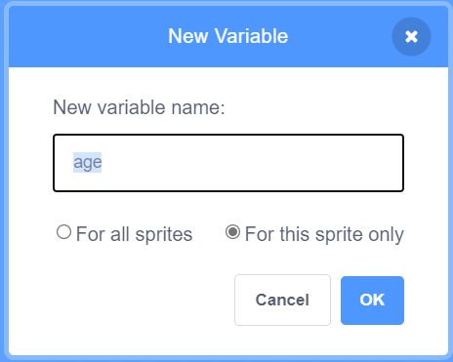
Making an age variable
Click Variables menu
click “Make a variable”
Type in “age”
Choose one of “for all sprites” and "for this sprite only”
Click OK

Slide 67
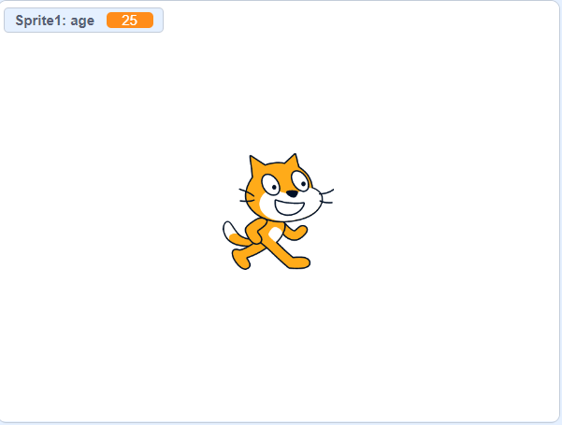
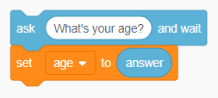
Assigning values to user defined variables
script
output

Slide 68
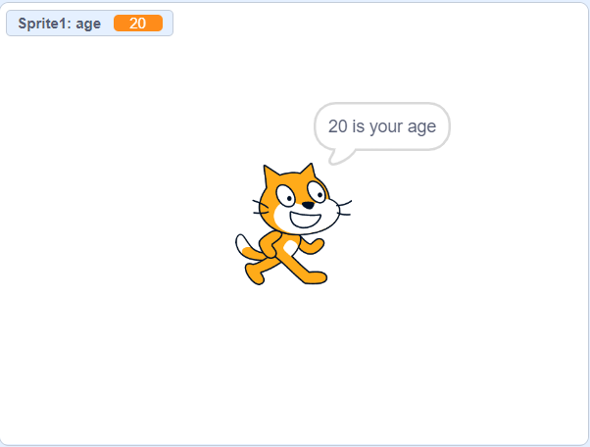
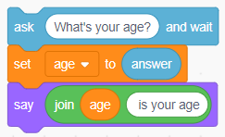
Concatenate text and variables
script
output

Slide 69
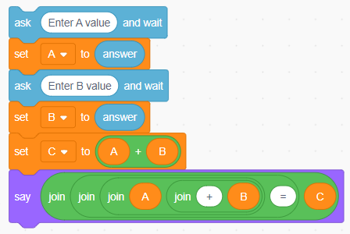
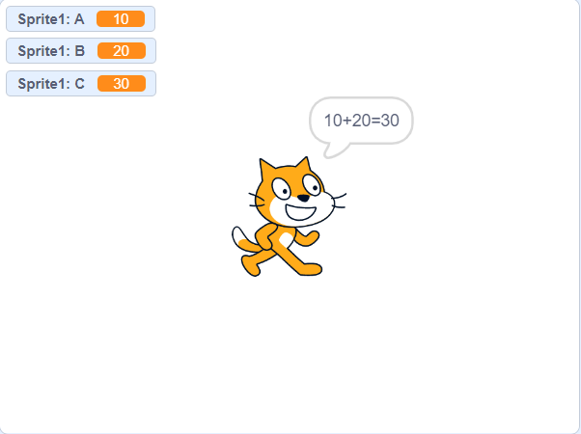
Computing C=a+b
steps
script
output
Make 3 variables, A, B, and C
Type in the values of A and B
Set the value of C to the sum of A and B

Slide 70
Computing average of two numbers
Average of two numbers (fix the two input values).
Change the values and re-run the script and observe the result.
Insert pauses where ever required.

Slide 71
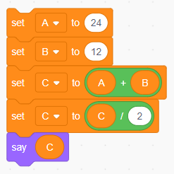
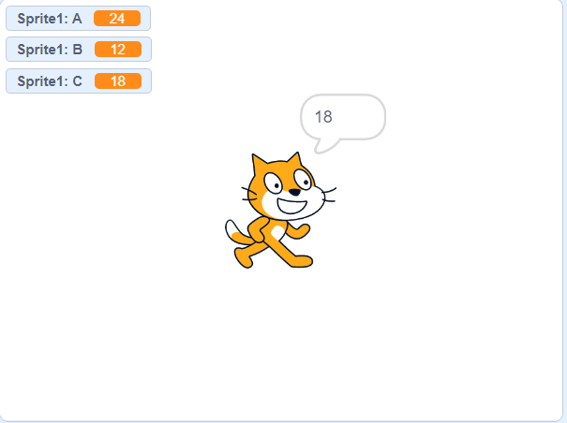
Script for average computation

Slide 72
Student exercise
Average of three numbers (fix the two input values).
Read the values from user instead of hardcoding.
Run the script with different input values and observe the result.
Insert pauses where ever required.

Slide 73
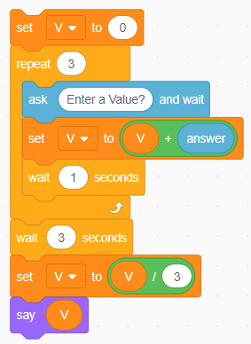
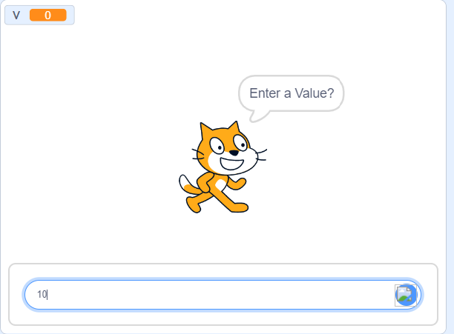
Student exercise-answer

Slide 74
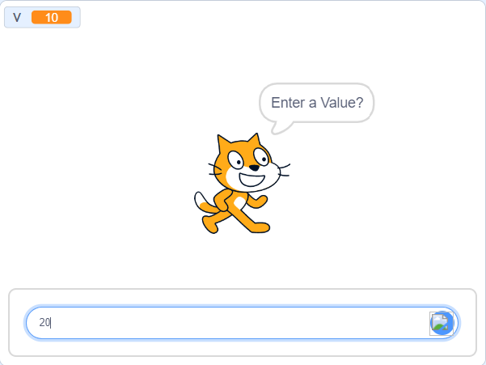
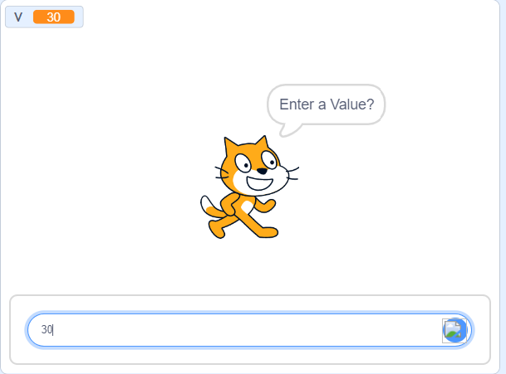
Student exercise-answer

Slide 75
Student exercise-answer

Slide 76
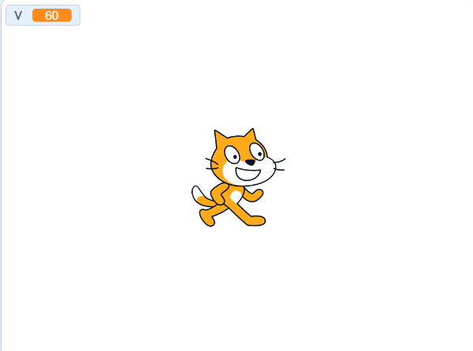
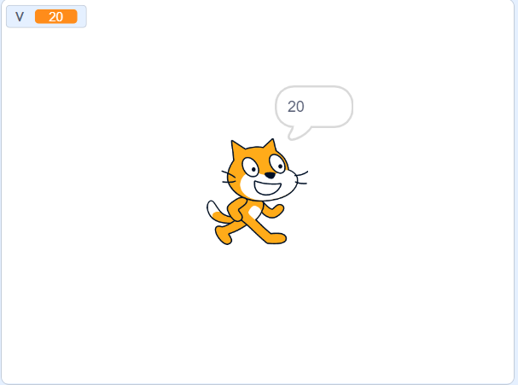
Student exercise-answer

Slide 77
Generate Fibonacci series
Create the scratch program to generate Fibonacci series.
Series is 0 1 1 2 3 5 8 11 … .
Generation continues till we interrupt the program.
Insert pauses where ever required.

Slide 78
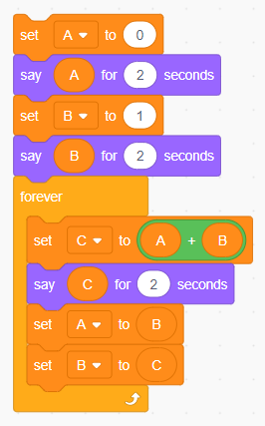
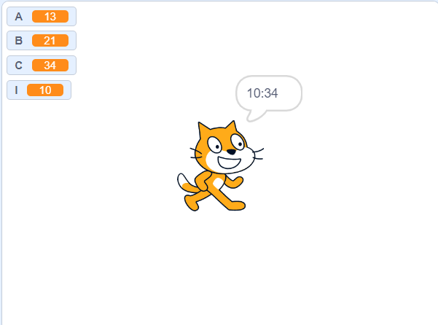
Fibonacci Script

Slide 79
Student Assignment
Create the scratch program to generate prime numbers between range of values.
For example, between 1 and 50 we have 2 3 5 7 11 13 17 19 23 29 31 37 41 43 47.
Insert pauses wherever required.

Slide 80
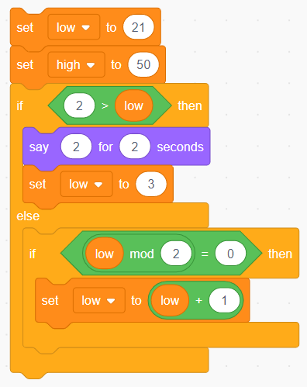
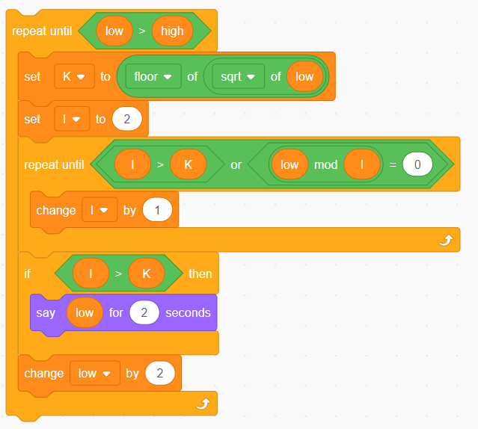
Student Assignment-answer

Slide 81
part four outcomes
Student should be able to write a program to ask the user for data, compute using the data, and report the answer to the user.
Students should be able to compute using common formulas.

Slide 82



Thank you
Dr. Ananda Kumar Kinjarapu
anandakumark@aec.edu.in
www.aec.edu.in

Slide 83
Table
 | Category 1 | Category 2 | Category 3 | Category 4
Item 1 | 4.5 | 2.3 | 1.7 | 5
Item 2 | 3.2 | 5.1 | 4.4 | 3
Item 3 | 2.1 | 1.7 | 2.5 | 2.8
Item 4 | 4.5 | 2.2 | 1.7 | 7

Slide 84





TEAM
Name
Title
Name
Title
Name
Title
Name
Title
Name
Title

Slide 85
Timeline
To start a presentation, go to the Slide Show tab, and select From Beginning.
1
To display Presenter view, in Slide Show view, on the control bar at the bottom left select the three dots, and then Show Presenter View.
2
During your presentation, the speaker notes are visible on your monitor, but aren't visible to the audience.
3
The Notes pane is a box that appears below each slide. Tap it to add notes.
4
If you don’t see the Notes pane or it is completely minimized, click Notes on the task bar across the bottom of the PowerPoint window.
5

Slide 86
Content
Subtitle
Subtitle
Add text, images, art, and videos.
Add transitions, animations, and motion.
Save to OneDrive, to get to your presentations from your computer, tablet, or phone.
Open the Design Ideas pane for instant slide makeovers.
When we have design ideas, we’ll show them to you right there.

Slide 87
Content
Subtitle
Subtitle
Subtitle
Add text, images, art, and videos.
Add transitions, animations, and motion.
Save to OneDrive, to get to your presentations from your computer, tablet, or phone.
Open the Design Ideas pane for instant slide makeovers.
When we have design ideas, we’ll show them to you right there.
This PowerPoint theme uses its own unique set of colors, fonts, and effects to create the overall look and feel of these slides.
PowerPoint has tons of themes to give your presentation just the right personality.

Slide 88

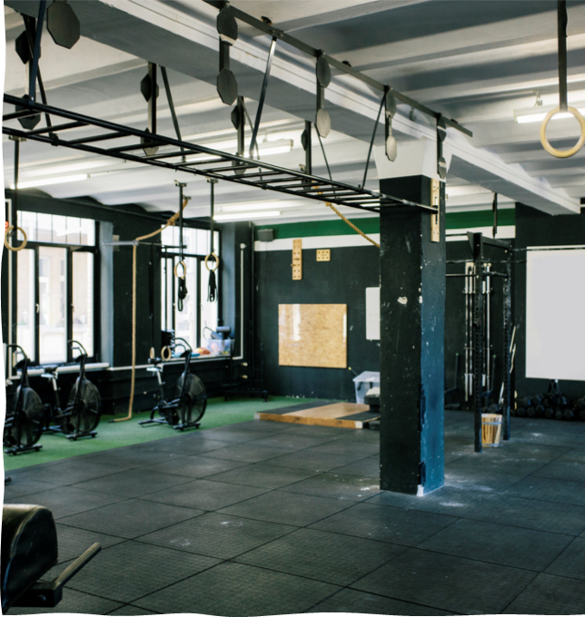


Summary
With PowerPoint, you can create presentations and share your work with others, wherever they are. Type the text you want here to get started. You can also add images, art, and videos on this template. Save to OneDrive and access your presentations from your computer, tablet, or phone.

